Slide 1
Mobile Application Development Introductory Lecture
Muhammad Azhar
muhammadazhar@uaar.edu.pk

Slide 2
Reference Materials
Paul, A., & Nalwaya, A. (2012). React Native for Mobile Development Harness the Power of React Native to Create Stunning iOS and Android Applications Second Edition. https://doi.org/10.1007/978-1-4842-4454-8
Allen, G. (2021). Android for Absolute Beginners. Berkeley, CA: Apress. https://doi.org/10.1007/978-1-4842-6646-5
Cheng, F. (2019). Flutter Recipes Mobile Development Solutions for iOS and Android. Berkeley, CA: Apress. https://doi.org/10.1007/978-1-4842-4982-6
Professional Android application development, Reto Meier, Wrox Programmer to Programmer, 2015.
iOS Programming: The Big Nerd Ranch Guide, Conway, J., Hillegass, A., & Keur, C., 5th Edition, 2014.
Android Programming: The Big Nerd Ranch Guides, Phillips, B. & Hardy, B., 2nd Edition, 2014.

Slide 3
Benefits of Mobile Apps
Business point of view
Accessibility
Loyalty and Customer Retention
Visibility
Brand Recognition
One stop interaction platform
Customers / Users point of view
Easy to Use
Instant notifications
Different apps with different benefits
Time effectiveness
Information on finger tips

Slide 4
3 Types of Mobile Apps
Web Apps
Runs on web browsers on mobile phones (Chrome, Mozilla Firefox, Safari)
Build using HTML / CSS / JavaScript
Advantages
Easy to build and maintain
Use any web technology / web programming language
Cheaper than native and hybrid apps
Single app for all platforms
Disadvantages
Need to run in a browser (High level dependency)
Slower than native apps
Less interactive and less intuitive
No application start icon on mobile desktop (Bad user experience)
Cannot be submitted to app store
Cannot interact with device utilities

Slide 5

Responsive Web Apps

Slide 6
3 Types of Mobile Apps
Native Apps
Most common types of mobile apps
Build for specific platform (Android, iOS, Windows Phones)
Build using native programming languages (Java, Swift, Objective C)
Advantages:
Faster than web and hybrid apps
Distributed in app store
Interactive and intuitive
Interacts with device utilities

Slide 7
3 Types of Mobile Apps
Native Apps
Disadvantages:
Single platform
Developed in complex and harder programming languages
Expensive
Hard to maintain

Slide 8
3 Types of Mobile Apps
Hybrid Mobile Apps
Combination of web and native mobile apps
Build in HTML / CSS / JavaScript
Runs inside of container / webview
Advantages:
Easy to build
Much cheaper than native apps
Single app for all platforms (Cross-platform apps)
No browser needed
Usually access device utilities using APIs
Faster to develop than native apps

Slide 9
3 Types of Mobile Apps
Hybrid Mobile Apps
Disadvantages:
Slightly slower than native apps
More expensive than web apps
Less interactive than native apps
Not as many plugins to interact with devices

Slide 10
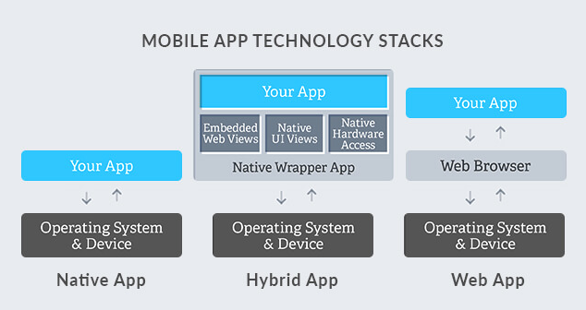
3 Types of Mobile Apps

Slide 11
Technologies for Hybrid Apps
React Native
Flutter
Xamrine
Ionic
Mobile Angular UI
Cordova / Phonegap
Sencha Touch

